Slide 1
Факультет МПиТК Кафедра «
Department «Information Security»
AI Enhanced Processors
Done by student of group IB-21: Ivanov I.I.

Slide 2
Факультет МПиТК Кафедра «
Tips to be covered:
The Moore’s law.
Pushing processing limits.
What are the AI enhanced processors?
The benefits of having purpose-built AI accelerators.

Slide 3
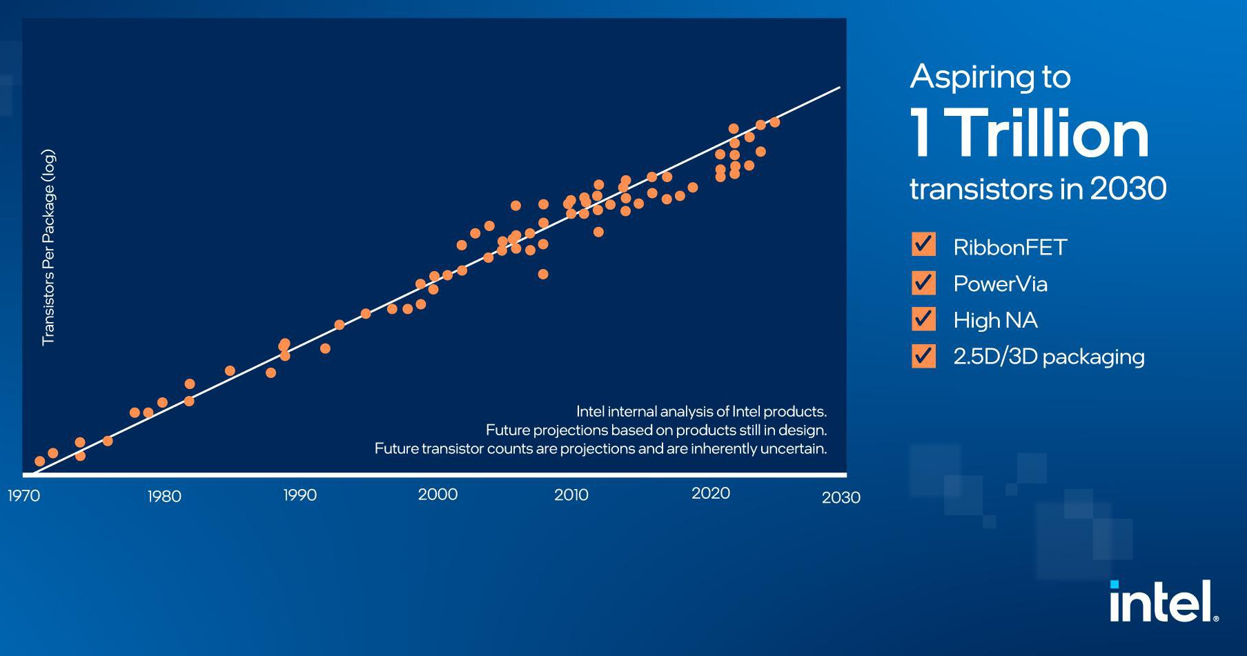
Факультет МПиТК Кафедра «
The Moore’s law
The rate of transistors count growth sustains just as the Moore’s law predicts.
But physically we are getting so close to the dead-end size of the single transistor.
But we might use some other techniques to increase the processing limits.

Slide 4
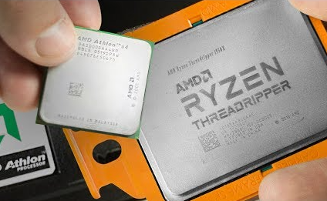
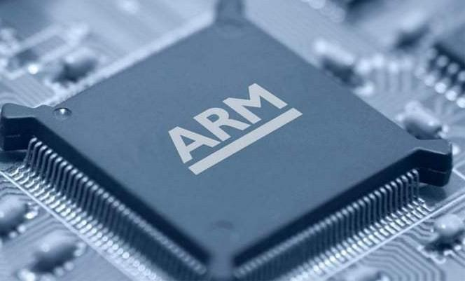
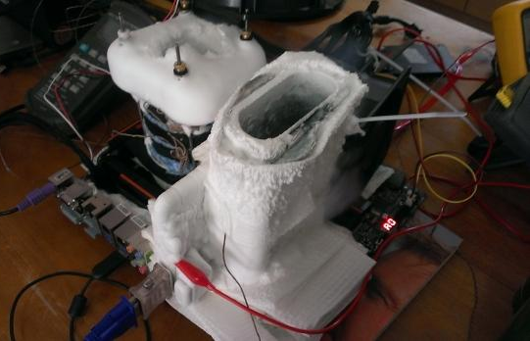
Факультет МПиТК Кафедра «
Pushing processing limits
Superscalar processors
The Reduced Instruction Set Computing (a.k.a. RISC)
Resolving a power consumption and cooling problems

Slide 5
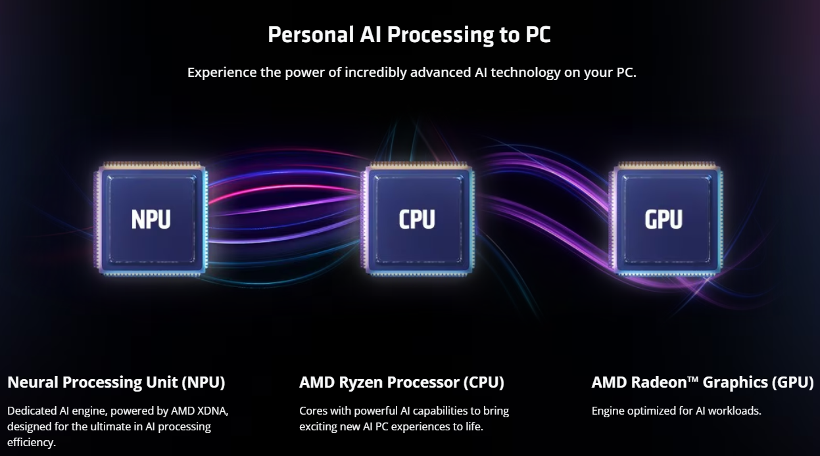
Факультет МПиТК Кафедра «
What are the AI enhanced processors?
The term AI processors encompasses both CPUs and discrete acceleration hardware, including GPUs, FPGAs, and purpose-built AI accelerators such as neural processing units (NPUs).

Slide 6

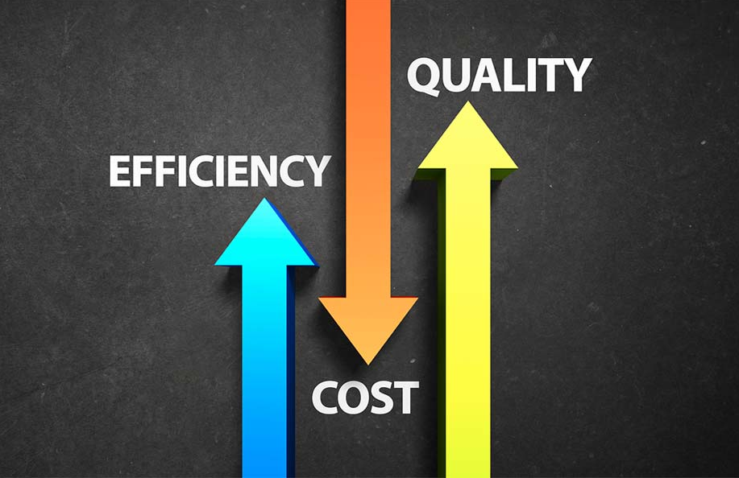
Факультет МПиТК Кафедра «
The benefits of having purpose-built AI accelerators
Performance Enhancement
Purpose-built AI accelerators in CPUs significantly boost the performance of AI workloads.
Cost Efficiency
AI enhanced CPUs are more cost-effective compared to using discrete GPUs.
Energy Efficiency and Sustainability
CPUs with integrated AI accelerators consume significantly less energy compared to GPUs, which is crucial for sustainability.

Slide 7
Факультет МПиТК Кафедра «
Conclusions
The integration of purpose-built AI accelerators within CPUs offers several significant benefits, particularly in the context of artificial intelligence (AI) workloads.
This undoubtedly leads to overall performance benefits since all processor loads can spread not only between the cores and threads of main processing units, but also these NPUs.

Slide 8
Факультет МПиТК Кафедра «
Thank you for your attention

